Slide 1

IBM SkillsBuild Decoding Data PBL Program 2025 Final Project Presentation
Project Name: Netflix Viewing Trends
Team Name: Yodha
College Name: University School of Information Communication and Technology Guru Gobind Singh Indraprastha University

Slide 2
Team Members
Skand Singh Chauhan (singhskand1109@gmail.com)
Suraj Singh Bisht (sjsinghbisht@gmail.com)

Slide 3
Introduction
Overview
This project analyzes the viewing trends of Netflix content using a dataset from Kaggle. It focuses on understanding the distribution and popularity of different types of content (Movies and TV Shows), release patterns, ratings, countries of origin, and genres.
The data is visually presented in an interactive Power BI dashboard, allowing users to explore insights through dynamic filtering options such as Release Year, Country, Genre, and Type.
Objective
The main objective is to:
Identify trends in Netflix content releases over the years.
Analyze genre and content type distribution (Movie vs. TV Show).
Determine country-wise contribution to Netflix’s content library.
Understand content ratings and their frequency.
Enable interactive exploration through slicers and filters to help users drill down by year, genre, type, or country.

Slide 4
Problem Identification
With the explosive growth of streaming platforms like Netflix, understanding what kind of content resonates with viewers has become essential. However, with a vast and constantly evolving content library, it becomes difficult to identify:
Which genres and types of content (Movies vs. TV Shows) are most popular?
What are the release trends over the years?
How does content distribution vary by country and rating?
Significance of the Problem
Content Strategy Optimization
Market Insights
Support for Emerging Creators and Regions
Trend Forecasting
Relevant Sustainable Development Goals (SDGs)
SDG 9 – Industry, Innovation, and Infrastructure
SDG 10 – Reduced Inequalities
SDG 12 – Responsible Consumption and Production
SDG 17 – Partnerships for the Goals

Slide 5
Data Collection
Sources of Data:- https://www.kaggle.com/datasets/shivamb/netflix-shows
Data Description
The Netflix dataset provides metadata for Movies and TV Shows, including key details like title, director, cast, country of production, date added to Netflix, release year, rating, duration, genres, and a brief description. Each title is uniquely identified by a show ID and categorized by type (Movie or TV Show). After preprocessing, essential columns such as Genre, Release Year, Country, and Type were cleaned and formatted to enhance visualization and analysis in Power BI.
Data Collection Methods
The dataset was likely compiled using web scraping techniques from Netflix's official site or via public API access. The data provider on Kaggle has made it available as a CSV file for analytical use. The project team downloaded the dataset from Kaggle, verified its structure, and performed cleaning steps

Slide 6
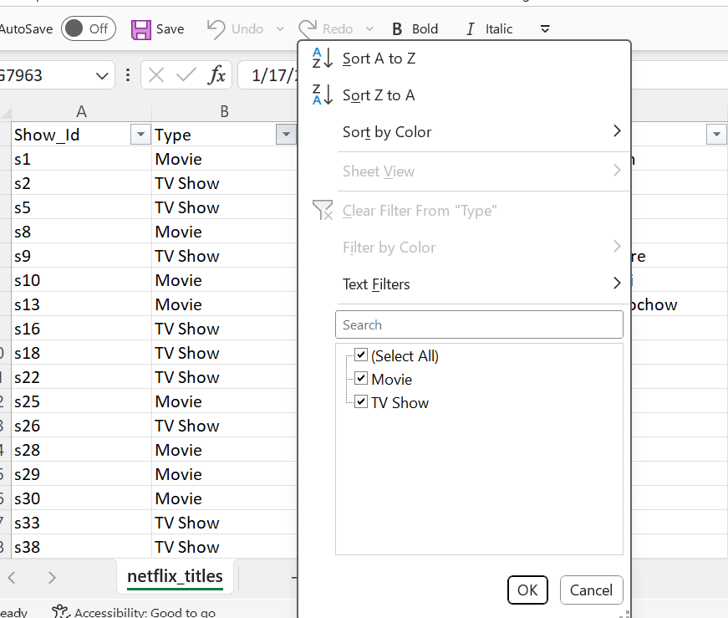
Data Preprocessing
Data Cleaning Methods
Standardizing Column Headers
Removing Duplicates
Filtering Out Blanks
Splitting Multi-valued Fields
Handling Missing Values
Blank Cells in ‘Country’
Missing ‘Date Added’ or ‘Release Year’
Blank Ratings
Data Transformation Techniques
Created New Columns in Power Query
Cleaned Genre/Type Columns
Country Simplification
Data Formatting

Slide 7
Data Analysis
Analytical Tools and Methods Used
1. Microsoft Excel
For initial data cleaning, filtering, formatting, and transformation.
Functions used: IF, ISBLANK, TEXT TO COLUMNS, YEAR(), SUBSTITUTE(), LEFT(), etc.
2. Microsoft Power BI
For creating an interactive, dynamic dashboard.
Used DAX (Data Analysis Expressions) for custom measures and calculated columns.
Implemented Slicers for filters (by Genre, Type, Year, Country).
Designed visuals: Pie Charts, Bar Charts, Line Graphs, and Card Metrics.
Key Findings
The analysis of 7,971 Netflix titles reveals that Movies make up the majority (71.3%), while TV Shows account for 28.7%. The USA, India, and the UK are the top content-producing countries. Content releases surged after 2010, peaking between 2017 and 2019. TV-MA is the most common rating, followed by TV-14 and TV-PG. Dominant genres include Action, Drama, Comedy, and Documentary. Most directors are linked to movies, reflecting the higher volume of film content.

Slide 8
Hypothesis Development
Formulated Hypothesis
“Drama is the most consistently popular genre across both Movies and TV Shows on Netflix over the years”.
Rationale Behind the Hypothesis
High Viewer Engagement: Drama typically includes emotional storytelling, relatable themes, and character development, which tend to attract a broad audience base.
Content Volume: From the dataset, initial genre counts show Drama appears frequently across various titles and years.
Cross-Type Presence: Drama appears both in Movies and TV Shows, suggesting its versatility and widespread appeal.
Global Trend: In international markets, Drama tends to be one of the most widely produced and consumed genres.

Slide 9
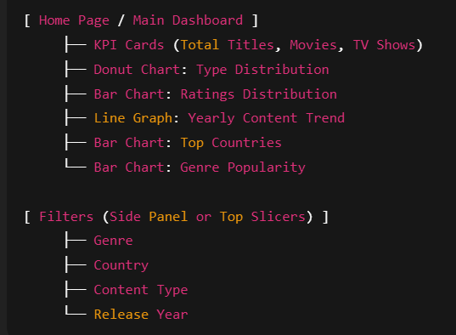
Visualization
Prominent features of the platform
The Power BI dashboard features interactive slicers for filtering by content type, genre, country, and release year. Line and bar charts display trends over time, top genres, countries, and rating distributions, while pie charts highlight content type shares. KPI cards present totals for titles, movies, and TV shows. Visuals are interactive, offering tooltips and cross-filtering capabilities. The layout is clean and professional, with clear legends, consistent colors, and intuitive labels for easy use by both technical and non-technical users.
Site Map

Slide 10
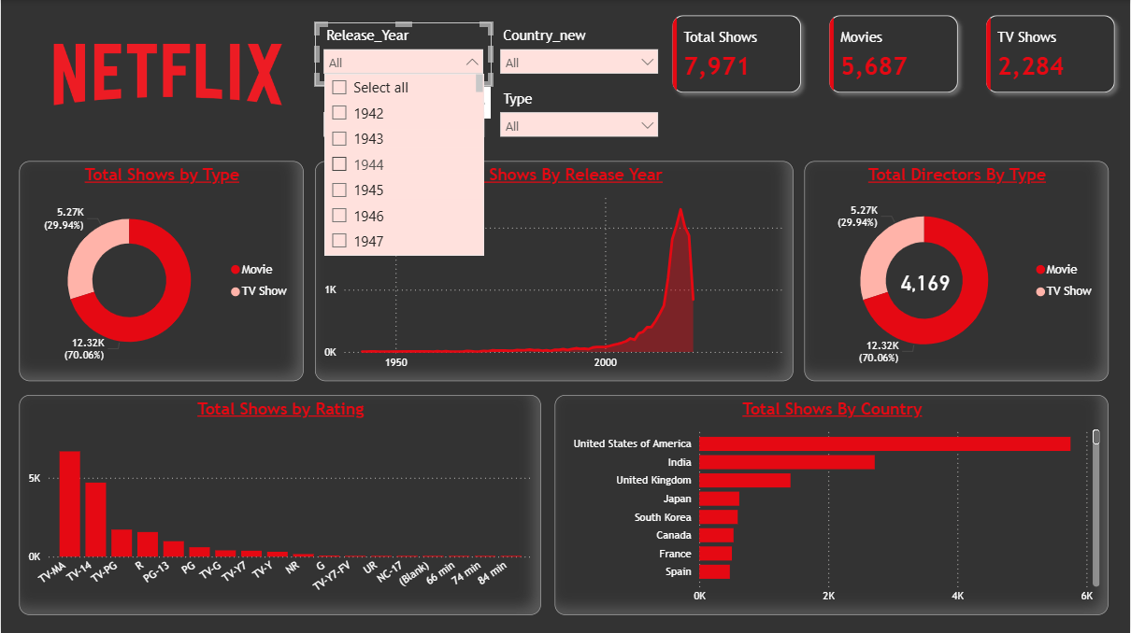
Conclusion
Future work
The current dashboard offers a strong foundation, with potential for deeper insights through future enhancements. Real-time data integration, sentiment analysis, and user demographics can enrich understanding. Genre co-occurrence and predictive analytics could further reveal trends and forecast popular content.

Slide 11
References
Tools and Software Used
Microsoft Excel
Microsoft Power Bi
Kaggle
Power Bi DAX
Text Functions in Excel
Additional References
Netflix Shows Dataset (Kaggle) https://www.kaggle.com/datasets/shivamb/netflix-shows
Microsoft Excel Documentation https://support.microsoft.com/excel
Power BI Learning Resources (Microsoft Learn) https://learn.microsoft.com/en-us/training/powerplatform/power-bi
UN Sustainable Development Goals (SDGs) https://sdgs.un.org/goals
DAX Guide for Power BI https://dax.guide

